Slide 1
Non-Traditional Market Making & Credit Risk Modeling

Slide 2
Agenda
Start | End | Item
 |  | Review
 |  | Non-Traditional Markets
 |  | Non-Traditional Market Evaluation
 |  | Break
 |  | Credit Risk Modeling
 |  | Homework Help 21. Turn in a script using TTR 22. Prepare & Score new lending club

Slide 3
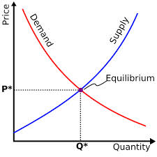
What is a Market?
Traditional Markets
Stock Markets
Bond Markets
Housing/Mortgages
Commodities – gold/silver etc
Crop Futures – corn/soybean
Consumer Credit
…
A market is one of the many varieties of systems, institutions, procedures, social relations and infrastructures whereby parties engage in exchange. Traditional markets are often regulated, have defined trading norms/rules, and have been in existence for some time.

Slide 4
What type?
Belief Based – some intrinsic value of the company is appealing and triggers a buy/selling action.
Fundamental Trading - traditional financial indicator triggers an action regardless of sector, or company product.
Technical Trading – trade based on “indications”
High Frequency Trading – “scalping” small profits repeatedly
In the previous class we evaluated technical indicators for established stock and equities, representing a traditional and established market.

Slide 5
Non-Traditional Markets
Traditional
Non-Traditional
Stock Markets
Bond Markets
Housing/Mortgages
Commodities – Gold, Silver etc.
Crop Futures
Consumer Credit
Crypto-currencies
Beanie Babies
Derivatives (originally)
Web Domains
…
In contrast to traditional markets, emerging or non traditional markets lack transparency, regulations and can often be manipulated more easily.
Higher risk should mean higher reward.

Slide 6
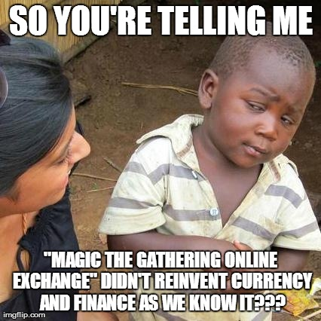

A non-traditional Market - Example
Owned by Hasbro, MTG is a 25 year old collectible trading card game. It is estimated that there are 8-12million players worldwide. Thus is it popular and has demonstrated longevity unlike other non-traditional markets.

Slide 7
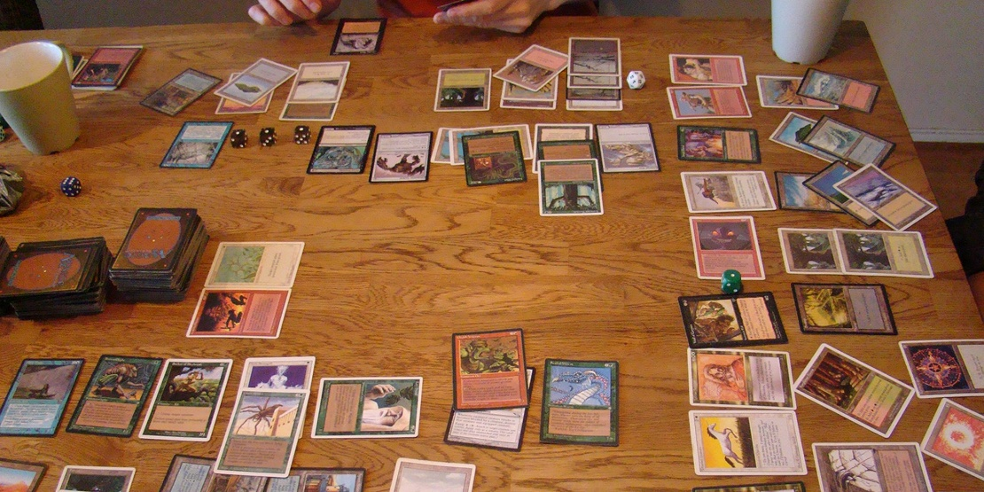
Magic The Gathering
Players create 60 card decks with cards of different abilities for a duel. Cards are fantasy based with creatures, sorceries, and mythical artifacts.

Slide 8
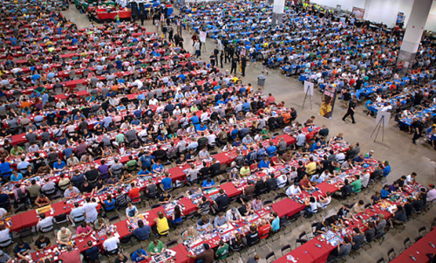
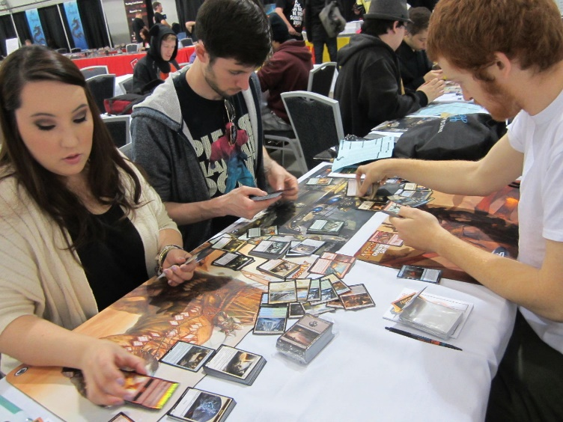
Magic The Gathering
Limited Print Runs
Varying Card Rarities
Rare cards are more powerful in the game

Slide 9
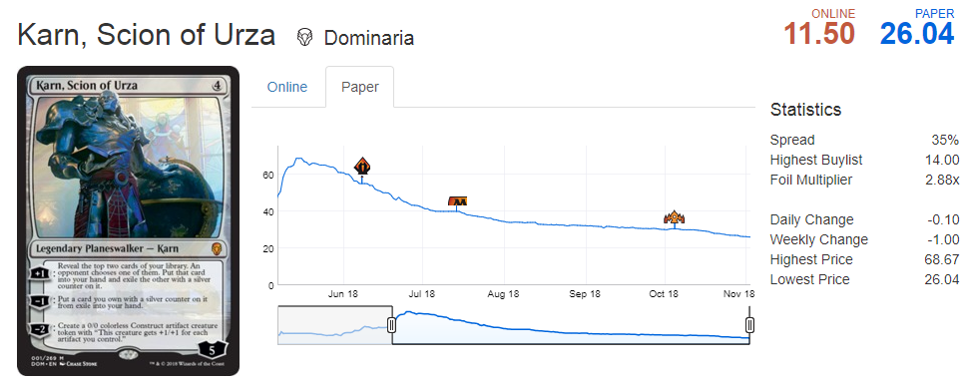
And that’s why it’s a market…
This card was as much as $65 before going lower to $26 when its abilities were not that good in the game. Sites like mtggoldfish.com and mtgstocks.com track prices across multiple sites.

Slide 10
So how do you get cards?
Say you are a player that needs to get Karn, Scion of Urza to complete a deck.
For $26
You could buy Karn from an online marketplace.
For $3
You can open a booster pack from the appropriate expansion set and hope you get it.
For $90
You can buy a booster box of 36 packs from the set and increase your odds of getting it while also getting many other potential valuable cards.
For $540
You can buy 6 of the booster boxes in a case.
Cards go out of print limiting the supply.

Slide 11

Limited Supply
Karn won’t be printed after 2018.
You could buy it from an online marketplace.
Find an older and still sealed booster pack and hope to get it.
As a result an old sealed booster pack commands a “gamblers premium”.

Slide 12
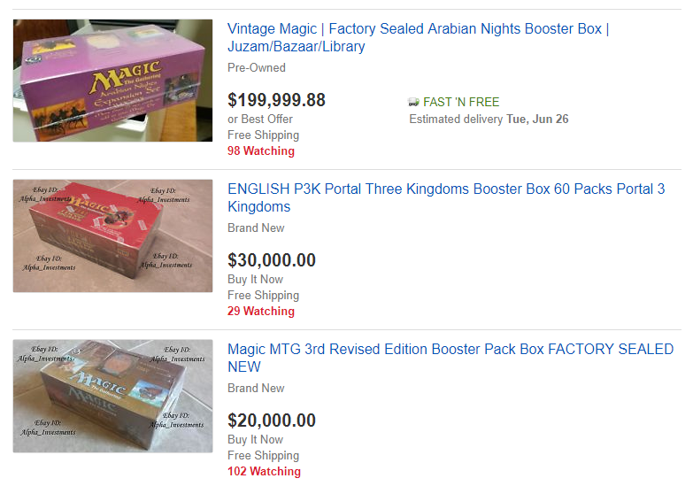

People Speculate as Supply Diminishes

Slide 13
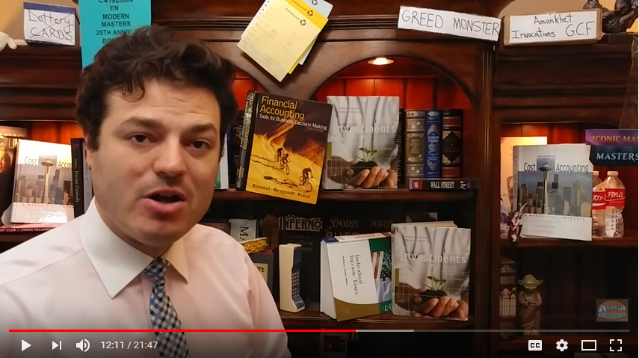
Real investing and speculation occurs.
6:30 – 8:30
https://www.youtube.com/watch?v=9OnBQt-8ntk
* Apologies for the brief profanity. Please leave the room if you are offended this isn’t my content.

Slide 14
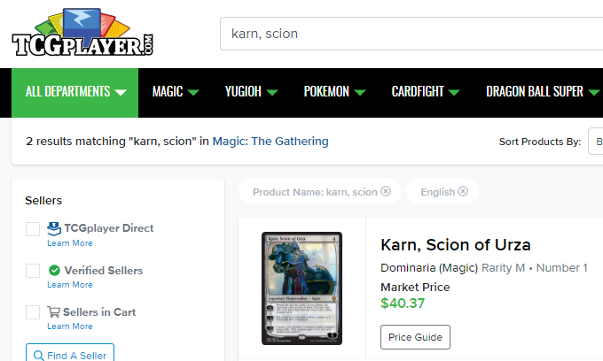
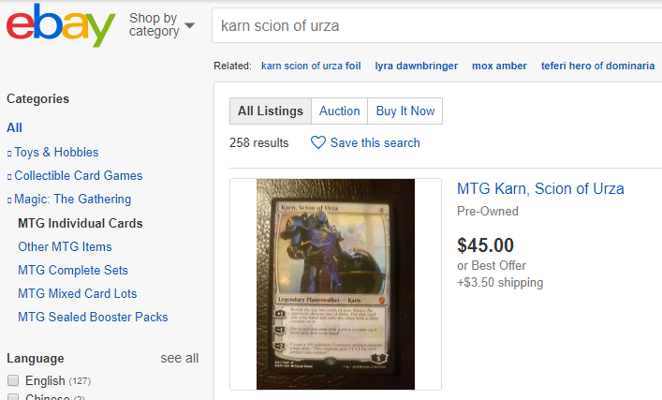
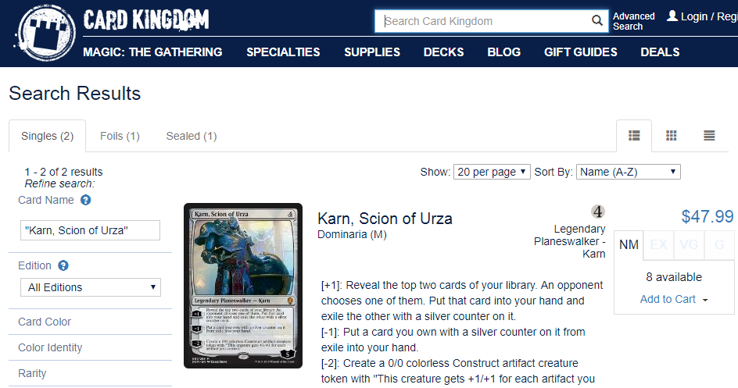
Where do market transactions occur?
Millions of USD each month transact based on card popularity in tournaments, game variations, pending reprints and speculation.

Slide 15
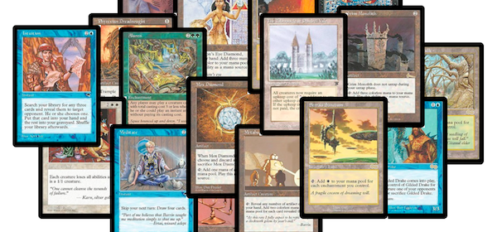
Making matters worse…
Hasbro’s subsidiary that publishes MTG, Wizards of the Coast, has an official reprint policy called “the reserved list.” The reserved list contains cards that were considered so powerful, they will not EVER be reprinted.
Many of the reserved list cards are old, and there are not many copies in existence.

Slide 16
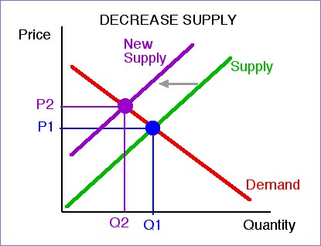
The reserved list…
The reserved list artificially reduces supply and virtually guarantees price stability in the future since the cards will not be reprinted. Further, as the game attracts new players, the demand curve shifts out.

Slide 17
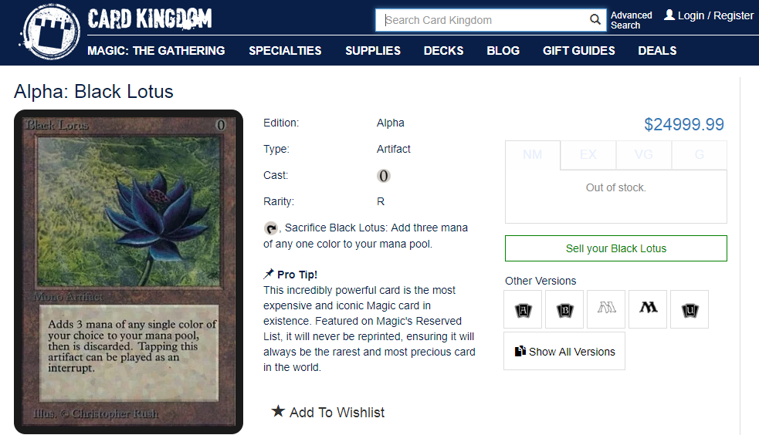
And that’s why it’s a market…to be manipulated
The most famous of the reserved list is the “Black Lotus”. Prices for this card range from $6500 to $25,000

Slide 18
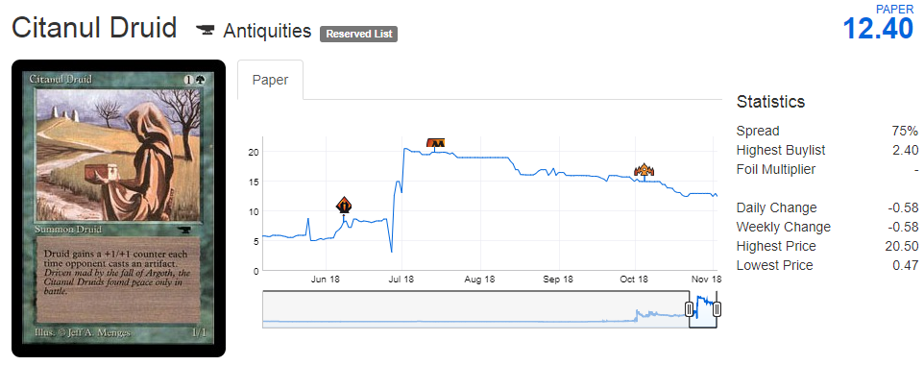
Reserved list buy out…
Over two weeks I bought 14 copies for $1-$5. The price spiked upwards to $7.50 and later others must have speculated on it because the price rose as high as $19 before declining.

Slide 19
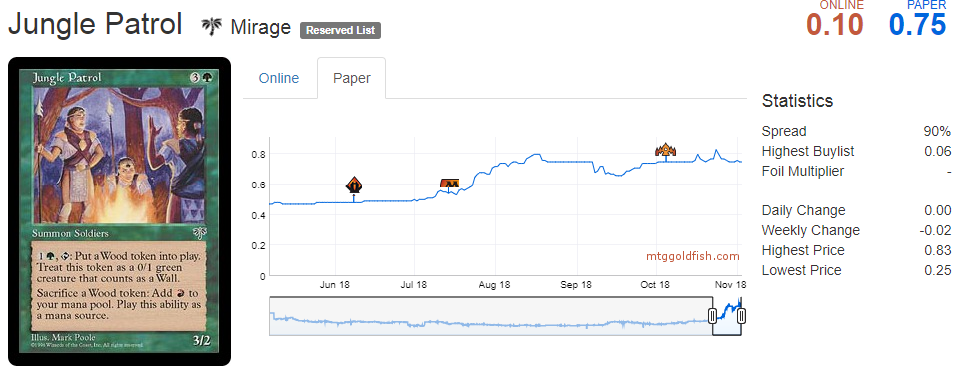
Reserved list buy out…FAILURE
I purchased ~100 Jungle Patrol cards for about $0.50 ea but this particular set has millions more cards so the price didn’t move.

Slide 20

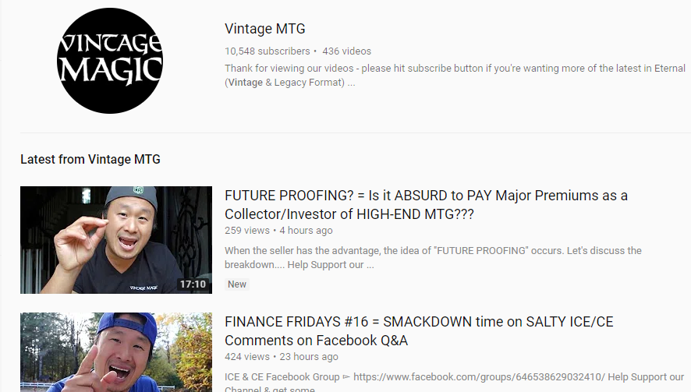
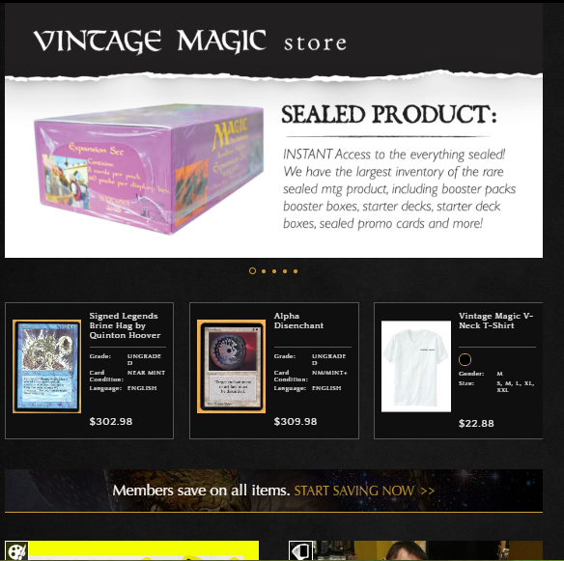
Non-Traditional Market Investor: Daniel Chang
Daniel is well known in the Magic Community, running a successful website, YouTube presence and storefront.

Slide 21
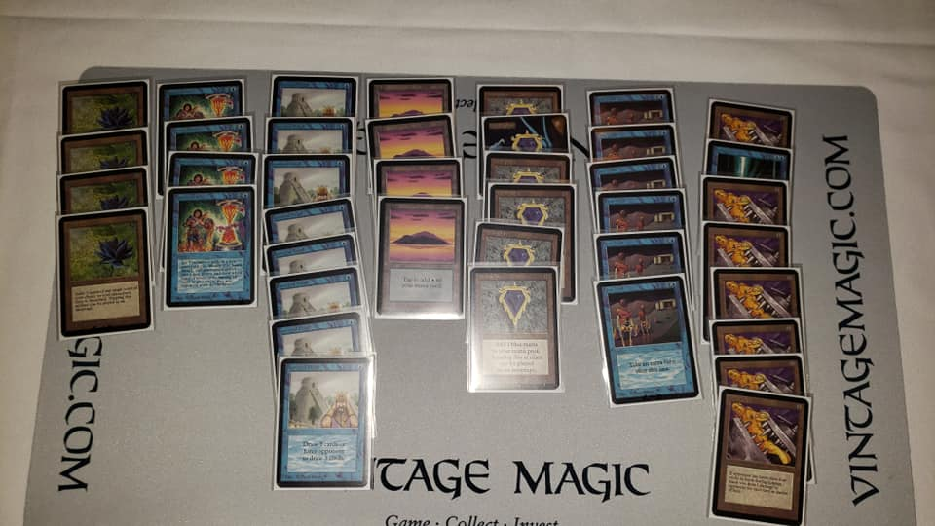
An “Alpha 40 deck”
From the original “alpha” set, these cards would cost about $500,000

Slide 22
Agenda
Start | End | Item
 |  | Review
 |  | Non-Traditional Markets
 |  | Non-Traditional Market Evaluation
 |  | Credit Risk Modeling
 |  | Homework Help 21. Turn in a script using TTR 22. Prepare & Score new lending club

Slide 23
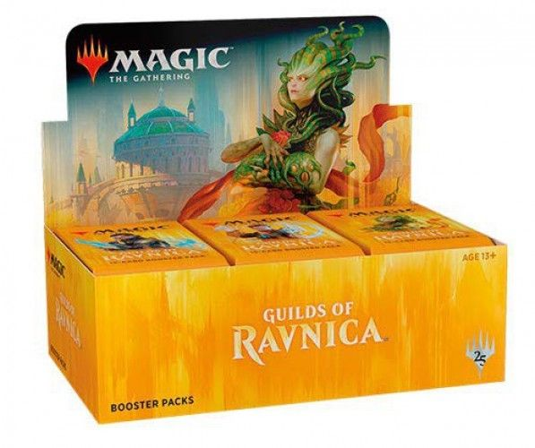
Regardless of the Reserved List
Newly printed cards are sold in 15 card packs.
Usually a pack contains
11 Commons
3 Uncommons
1 Rare
1 in 8 packs will replace the rare with a mythic
1 in 6 packs will have a random premium foil card replacing a common.

Slide 24
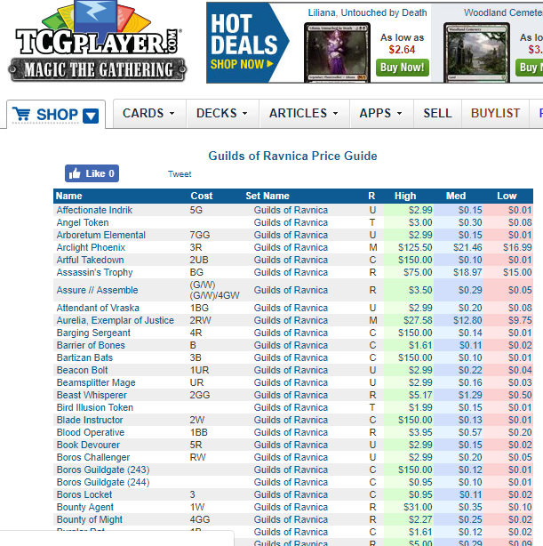
Custom Package/Functions Simulating Opening Packs & Boxes
http://magic.tcgplayer.com/db/search_result.asp?Set_Name=Guilds%20of%20Ravnica
Guilds of Ravnica
266 Cards Total
16 Mythic
53 Rare
80 Uncommon
114 Common
Since we know the cards in a set, their prices, and the probabilities of getting specific cards, we can simulate pack openings.

Slide 25
Modeling Risk/Reward outside of the Reserved List
When you open a pack:
Risk:
Each expansion set has varying prices. Some cards are worthless while other cards can be expensive..
Reward:
Some packs will contain expensive cards which you can immediately sell for more than the cost of the pack.
Since we know the cards in a set, their prices, and the probabilities of getting specific cards, we can simulate pack openings.
*Keep in mind there are friction costs, shipping a physical good takes time and money.

Slide 26
Custom Package Simulating Opening Packs & Boxes
Get Set’s card and pricing information
1
Simulate opening a 15 card pack
2
Depending on rarity, and “foil” pricing distributions are made with the H/M/L prices
3
Simulate 1000 pack openings to arrive at an average expected value.
4
$$$
No such thing as a bad set, only a bad price to pay for a pack, box or case.

Slide 27
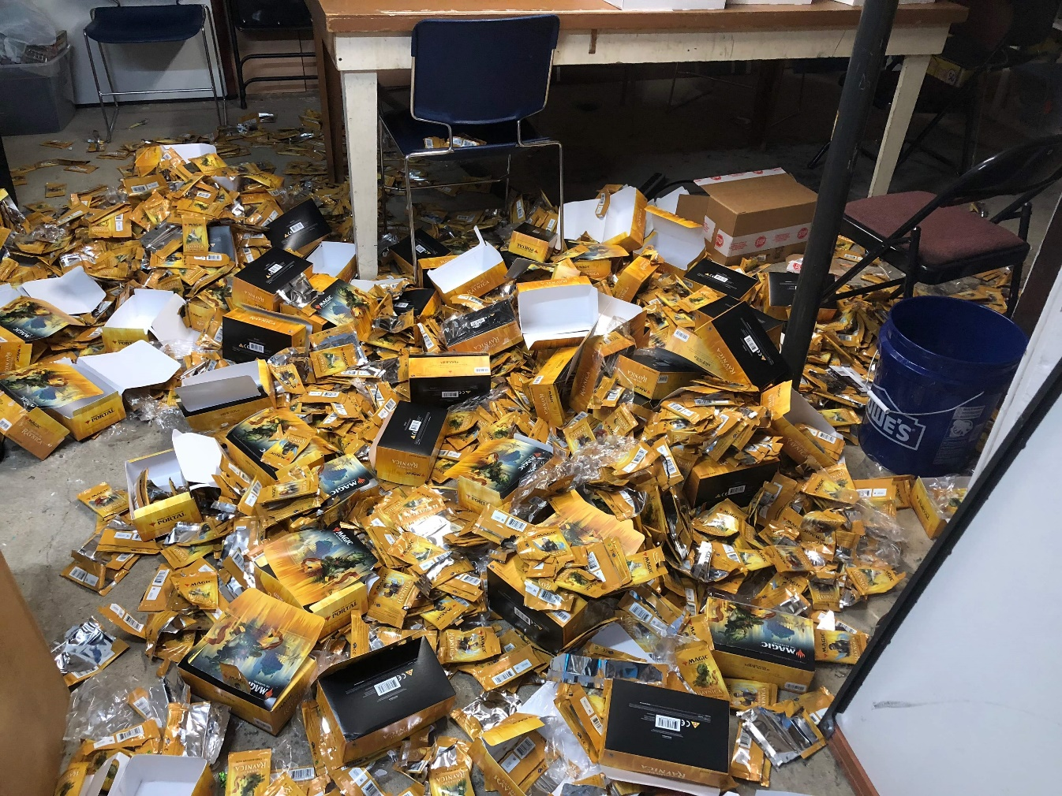
Open 1_SimulateBoosters_REVISED.R

Slide 28
Agenda
Start | End | Item
 |  | Review
 |  | Non-Traditional Markets
 |  | Non-Traditional Market Evaluation
 |  | Break
 |  | Credit Risk Modeling
 |  | Homework Help 21. Turn in a script using TTR 22. Prepare & Score new lending club

Slide 29
What is a Market?
Traditional Markets
Stock Markets
Bond Markets
Housing/Mortgages
Commodities – gold/silver etc
Crop Futures – corn/soybean
Consumer Credit
…
A market is one of the many varieties of systems, institutions, procedures, social relations and infrastructures whereby parties engage in exchange. Traditional markets are often regulated, have defined trading norms/rules, and have been in existence for some time.

Slide 30

Consumer Credit - Lending Club
US consumers apply for various loans and instead of banks providing funds, everyday consumers fund the loan by purchasing “notes” and receive the interest.
Peer to Peer funding for
Personal Loans
Auto Loans
Small Business Loans
Medical Loans
Everyday investors can accept the loan risk – making it a new banking distribution model
Consumer credit is a traditional market. There are defined inputs (credit score), consumer protections (usury laws), and established distribution (credit applications).

Slide 31
What’s the Risk?
Risk
Mitigation
Over exposure in a single loan
Diversify – Do not fund more than $25 on a single loan
Early payment reduces interest received
Monitor & re-invest monthly
Illiquid – notes are 36-60 months
Buy notes with 36m horizons
Default – debtors that stop paying
Model the probability of default

Slide 32
What’s the Reward?
Reward
Result
Interest is imposed by LC
Investors have no input to the amount
Usually lower rates for the applicant
Lower capital cost for debtor
LC takes 1% of interest
Reduces reward incentive for investor
Remaining interest is paid monthly to note holders.
Investors act as banks & receive consistent returns

Slide 33
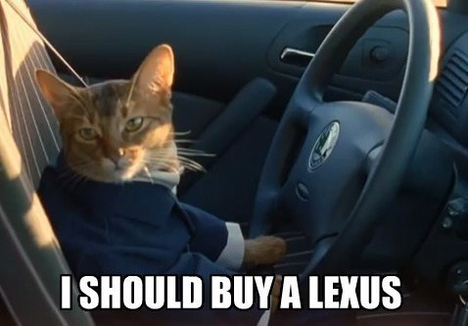
Example
Erin decides to buy a car. Instead of a traditional loan she applies at LC.
Erin applies for a $10k car loan
LC assesses her creditworthiness & posts a $10k loan @ 6% interest on the investor site.
Trish & hundreds of other LC investors fund the loan in $25 increments called “notes”
Each month Erin pays her loan, LC takes 1% and the investors make 5% on their outstanding notes.

Slide 34
Data
11 yrs of historical performance – Over 1M notes publicly available
Some platform changes in that time
Datasets are updated monthly
Sampled to 20k – either in fully paid of charged off state
Loan Origination
36 or 60 Monthly Payments
Fully Paid
1 = Success Class
Transitional States of Nature:
Grace Period, 30-60,60-90 days
0 = Failure Class
Charged Off
https://www.lendingclub.com/info/download-data.action

Slide 35
Plan
We will model 0/1 probability of success (fully paid)
Methods
Artifacts
Cross Validation for stability of results
Rpart decision tree
Random Forest
Logistic Regression with CV
Compare results – Choose method & score new notes
Identify the most probable notes for being fully paid
Understand important variables
Visualize probability of success/interest rate (reward)
Depending on risk propensity, purchase X notes.

Slide 36
What is cross – validation?
Our previous partitioning schema had training, test and sometimes a holdout set.
Training Data
All Data
Test Data

Slide 37
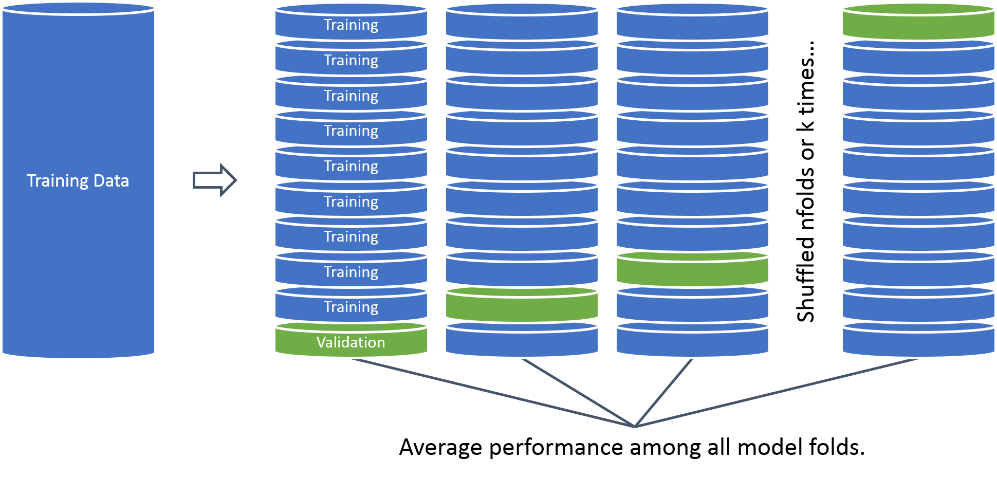
What is cross – validation?
Now we segment & rotate our data. This introduces a new tuning parameter & increases model training time.
Why would this be a good idea?

Slide 38
Open 2_CreditModeling_A.R
Let’s make a simple decision tree.

Slide 39
Open 2_CreditModeling_B.R
Let’s make a randomForest w/manual preprocessing.

Slide 40
Open 2_CreditModeling_C.R
What about our old friend logistic regression?
We will perform variable treatment
We will cross-validate results
This gives the model an unfair advantage over the last two but should demonstrates the power of data clean up.

Slide 41
Cutoff Threshold
Is 0.50 the optimal cutoff?
Should we be equal weighted?
Do we care equally about picking paying notes and charged off loans?

Slide 42
The cost of getting it wrong is high!
Is 0.50 the optimal cutoff?
We have ample opportunity to pick high probability notes so it best to be precise, throwing out many hundreds of notes that are still likely to be paid fully.
Another example where adjusting the cutoff may be good.
Disease Detection? High or Low?
What if the idea is to save lives? What about saving costly medical test?
What other examples of non-50% cutoff could be appropriate?

Slide 43
Armed with our three algo’s let’s choose the best.
Open 2_CreditModeling_D.R

Slide 44
Agenda
Start | End | Item
 |  | Review
 |  | Non-Traditional Markets
 |  | Guest Speaker Daniel Chang
 |  | Non-Traditional Market Evaluation
 |  | Credit Risk Modeling
 |  | Homework Help 21. Turn in a script using TTR 22. Prepare & Score new lending club

Slide 45
Time to buy some loans!
Open 2_CreditModeling_E_REVISED.R

